Slide 1

Chapter 13
How to work with forms
Notes:
Session: Ghi số thứ tự session trong môn học
Session Name: ghi tên của session sẽ dạy

Slide 2
Objectives
How to use forms and controls
Other skills for working with forms
How to use the HTML5 features for data
validation
How to use the HTML5 controls
A web page that uses HTML5 data validation
Notes:
Mô tả nội dung mà học viên phải đạt được khi kết thúc môn học này

Slide 3
How to use forms

Slide 4
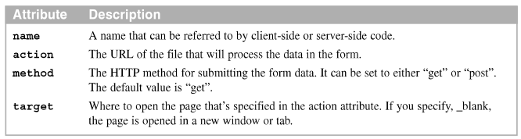
An introduction to a form
A form contains one or more controls like text boxes, radio buttons, lists, or check boxes. That is permit user enter the data and submit to server.
Attributes of the form element

Slide 5
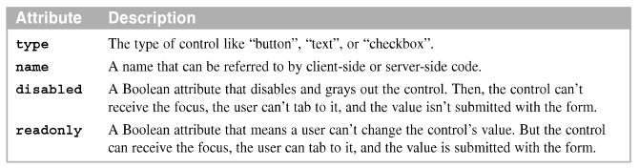
How to create a form (cont.)
Attributes common to most input elements

Slide 6
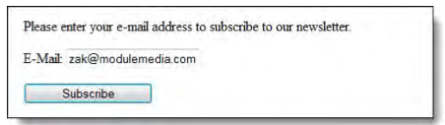
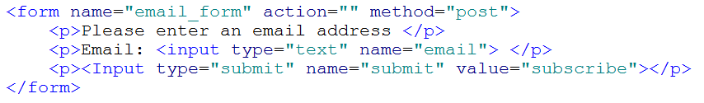
How to create a form (cont.)
The form in a web browser
HTML Code

Slide 7
How to use controls

Slide 8
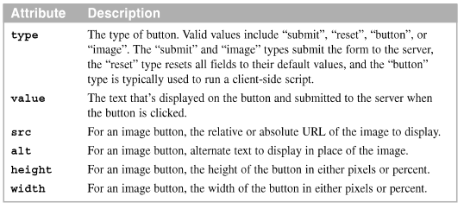
How to use buttons
Use the input element to create four different types of buttons
Attribute of the input element for button and for the buttons and for the button element

Slide 9


How to use buttons (cont.)
The buttons in a web browser

Slide 10
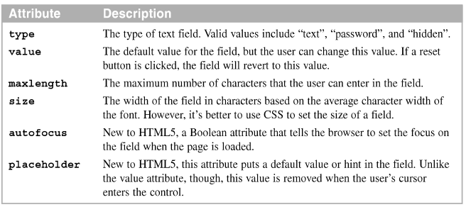
How to use text fields
There are several types of text field. The three most common are text, password, and hidden
Attributes of the input element for text fields

Slide 11
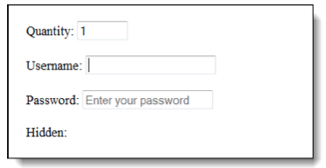
How to use text fields (cont.)
The text fields in a web browser

Slide 12
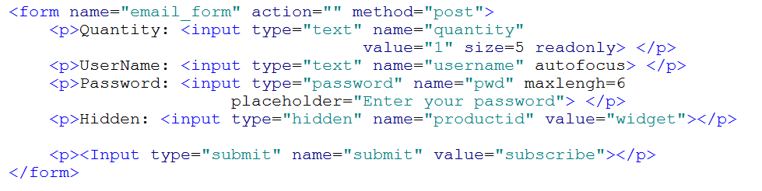
HTML code

Slide 13
How to use radio buttons and check boxes
Only one radio button in a group can be selected at on time. The radio button in a group must have the same name attribute, but different values
Check boxes are unrelated, more than one check box can be checked at the same.

Slide 14
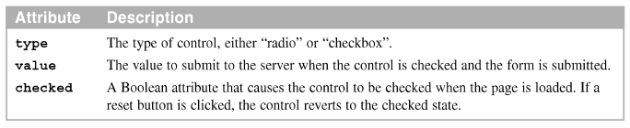
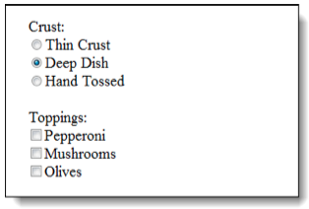
How to use radio buttons and check boxes (cont.)
Attribute of the input element for radio buttons and check boxes
The radio buttons and check boxes in a web browser

Slide 15
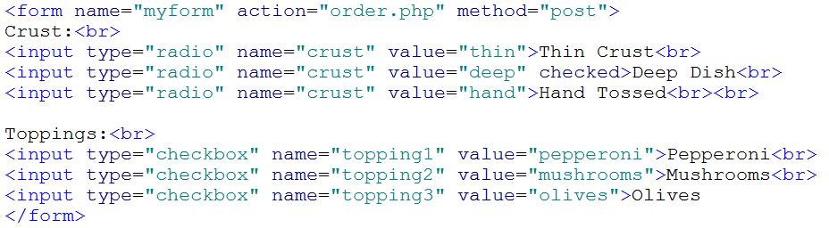
HTML - Code

Slide 16
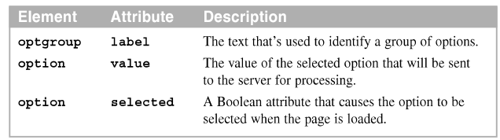
How to use drop-down lists
To create a drop-down list, code a select element that contains option elements.
Attribute of the optgroup and option elements

Slide 17
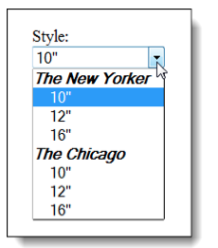
How to use drop-down lists (cont.)
The drop-down list in a web browser when the use clicks on the arrow

Slide 18
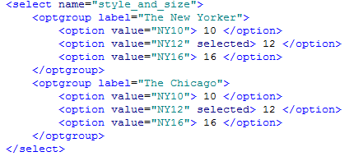
How to use drop-down lists (cont.)

Slide 19
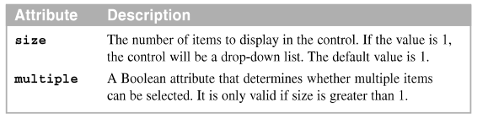
How to use list boxes
A list box display the number of options you specify on the size attribute.
Attribute of the select element for list boxes

Slide 20
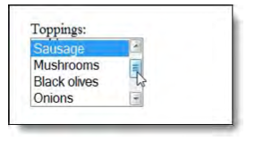
How to use list boxes (cont.)
The list box in a web browser with a scroll bar

Slide 21
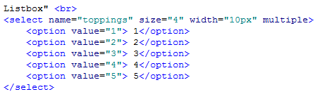
How to use list boxes (cont.)

Slide 22
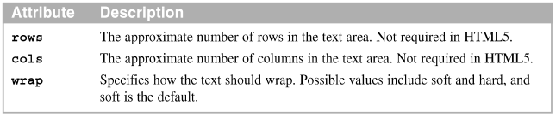
How to use text areas
A textarea field (or just text area) can be used to get multi-line text entries.
Attributes of the textarea element

Slide 23
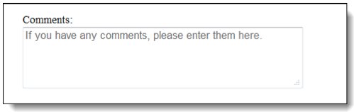
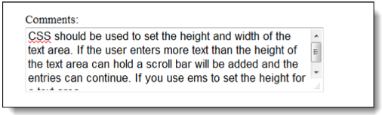
How to use text areas (cont.)
The text area in a web browser
The text area after text has been entered into it

Slide 24
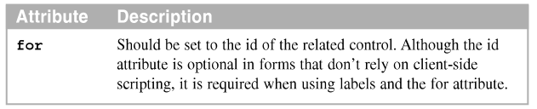
How to use labels
A label is commonly used to identify a related field.
Labels also make it easier to align the controls on a web page.
Attribute of the label element

Slide 25
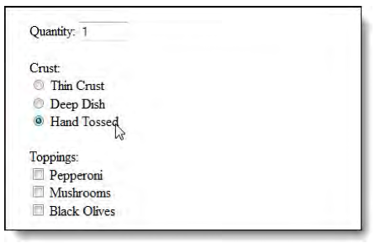
How to use labels (cont.)
The HTML in a browser as the user clicks on a label to check it box

Slide 26
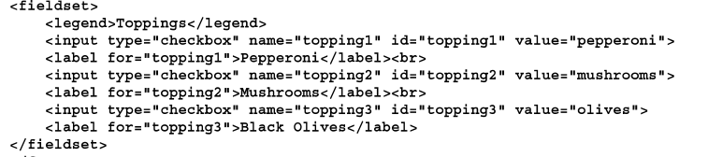
How to group controls with fieldset and legend elements
The fieldset element is used to group controls
The legend element can be coded within a fieldset element.
HTML that uses fieldset and legend element:

Slide 27
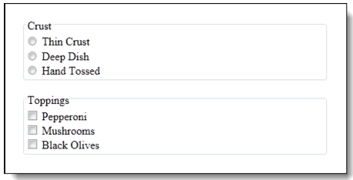
Example
The elements in a web browser

Slide 28
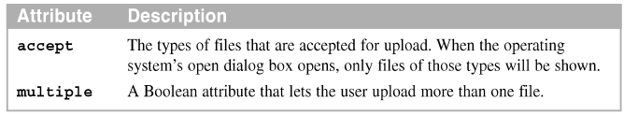
How to use a file upload control
To create a file upload control, code the input element with “file” as the type attribute.
Attributes of the input element for a file upload control

Slide 29
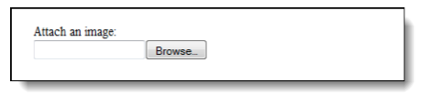
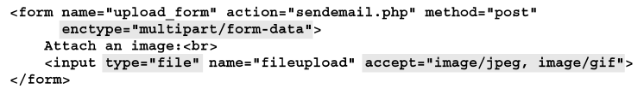
How to use a file upload control (cont.)
The file upload control in the Firefox browser
The HTML for a file upload

Slide 30
Other skills for working with forms

Slide 31
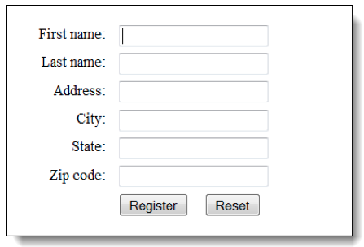
How to align controls
Label, textbox, and button controls aligned on a form
Notes:
Mô tả nội dung chi tiết từng chuyên đề

Slide 32
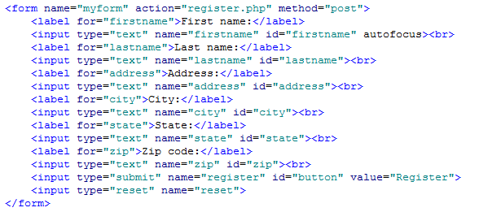
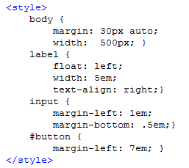
How to align controls -2

Slide 33
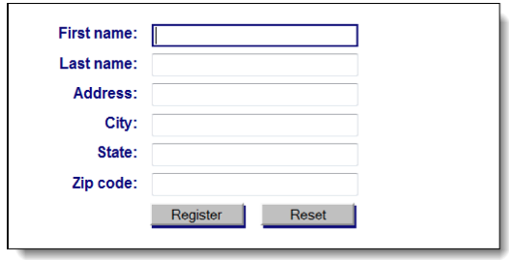
How to format controls
The form with some additional formatting

Slide 34
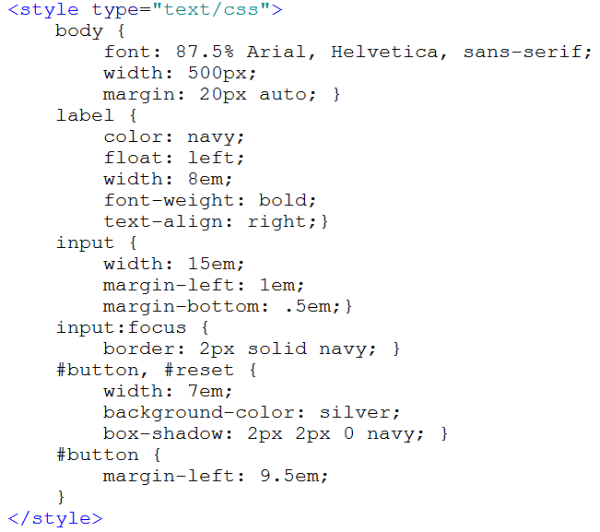
How to format controls

Slide 35
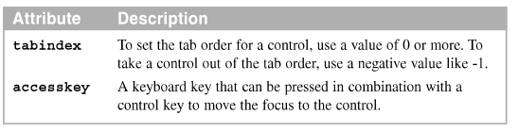
How to set the tab order and assign access keys
The tab order for a form is the sequence in which the controls receive the focus when the Tab key is pressed.
The attribute for setting the tab order and access keys

Slide 36
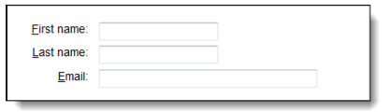
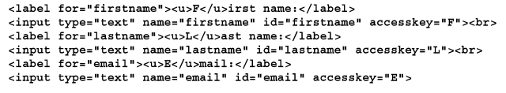
Example
Three labels with access keys
The HTML for the controls

Slide 37
How to use the HTML 5 features for data validation

Slide 38
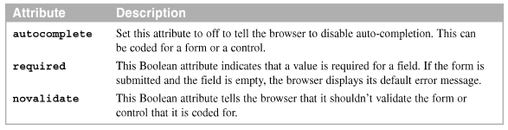
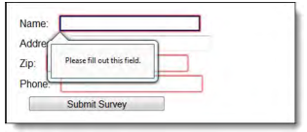
The HTML5 attributes for data validation
The HTML5 attributes for data validation
The error message and highlighting used by Firefox

Slide 39


CSS3 selectors for data validation
The CSS3 pseudo-classes for required, valid, and invalid fields
A CSS attribute selector for all controls with the required attribute

Slide 40
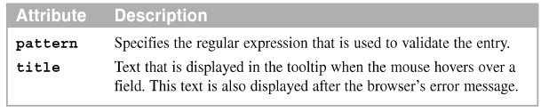
How to use regular expressions for data validation
A regular expression is a standard language that provides a way to make a user entry against a pattern of characters.
Attribute for using regular expressions

Slide 41
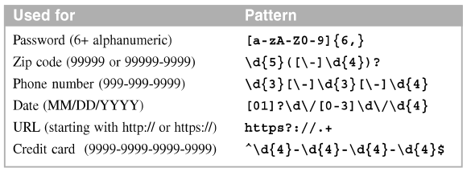
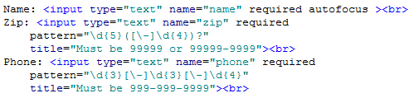
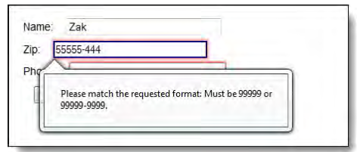
Pattern
Patterns for common entries
Code for pattern

Slide 42

How to use a datalist to present entry options
Use the new HTML5 datalist element to provide a datalist of entry options for a fields.
Attributes for the options elements within a datalist element

Slide 43
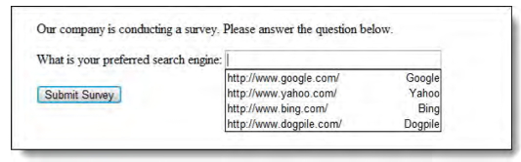
Datalist example
The form on the browser

Slide 44
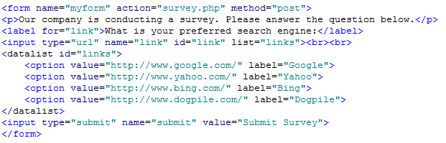
Datalist - Code

Slide 45
How to use the HTML 5 controls

Slide 46
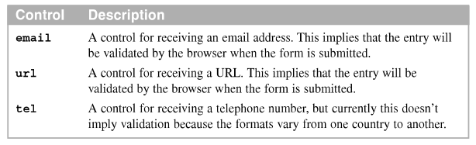
How to use the email, url, and tel controls
The HTML5 email, url, and tel control are designed for email address, URL and telephone number entries

Slide 47
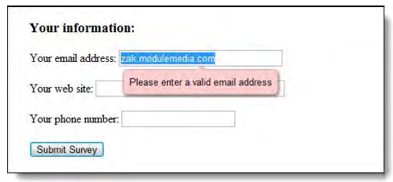
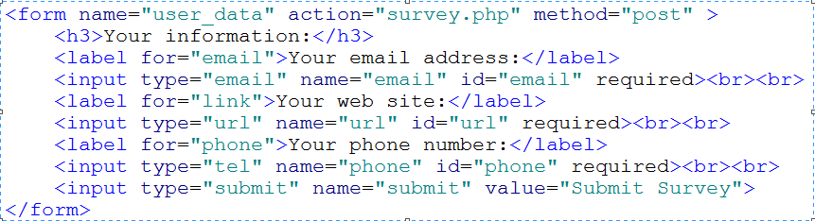
Example

Slide 48
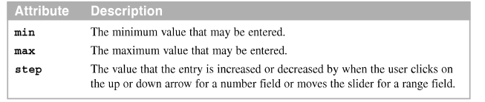
How to use the number and range controls
The HTML number and range controls are designed for numeric entries
Attribute for the number and range controls

Slide 49
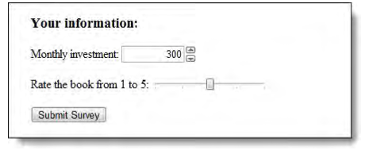
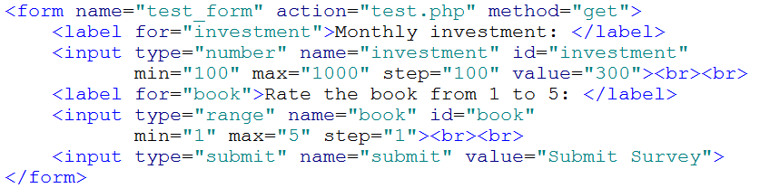
Example

Slide 50
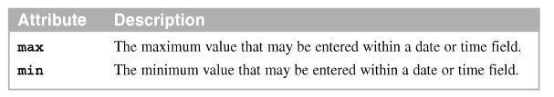
How to use the date and time controls
The HTML5 date, datetime, datetime-local, month, week, and time control are designed for date and time entries
Attribute for the date and time controls

Slide 51


Example

Slide 52


How to use the search control for a search function
A search function that uses a search control in browser
The HTML for using the Google search

Slide 53

How to use the color control
The HTML for a color control
The color control in browser

Slide 54

How to use the output element to display output data
This control is designed to display data that is calculated by client side or server side scripting language
An attribute for the output element

Slide 55


Example

Slide 56

The progress and meter element to display output data
These controls are designed to displayed data in progress bar or meter form
Attribute for the progress and meter elements

Slide 57

Example

Slide 58

HTML - Code

Slide 59
A web page that uses HTML5 data validation

Slide 60

The page layout
A web page in Browser with a form that uses HTML5 validation

Slide 61

The HTML
The HTML for the form

Slide 62

The CSS
The CSS for the form

Slide 63
Summary
A form contains one or more controls like text boxes, radio button, or check boxes that can receive data
A submit button submits the form data to the server
The controls label, text field, radio, button, check box, drop-down, list boxes and text area
Use file upload control
Use CSS align
The tab order of a form
Notes:
Tóm tắt lại nội dung đã học

Slide 64
Summary
Access key are shortcut keys that the user can press to move the focus on control
HTML5 provide data validation and CSS3 pseudo-classes for formatting required, valid, and invalid fields
HTML5 provide regular expressions
HTML5 provide the email, url, tel, number, range, date, time, search, and color controls

Slide 65
Discussion
Notes:
Trả lời câu hỏi WHY?

